Slide 1
Framework for Measuring Productivity in Air Force Facility Maintenance and Repair
Capt Jim Daniels
7 June 2016

Slide 2
Overview
Overview
Problem Summary
Data Summary
Research Statement
Analysis Techniques
Results
Literature Search
Problem Summary
Data Summary
Research Statement
Analysis Techniques
Results Presentation
Literature Search

Slide 3
Problem Summary
Overview
Problem Summary
Data Summary
Research Statement
Analysis Techniques
Results
Literature Search
Limited funding and manpower combined with aging facilities
CE Operations Flight
Every scheduler’s meeting is run differently
Flight commanders gut feeling on how to get as much done as possible
Standardize Productivity
Work Request completed per hours of labor
Create a baseline for improvement

Slide 4
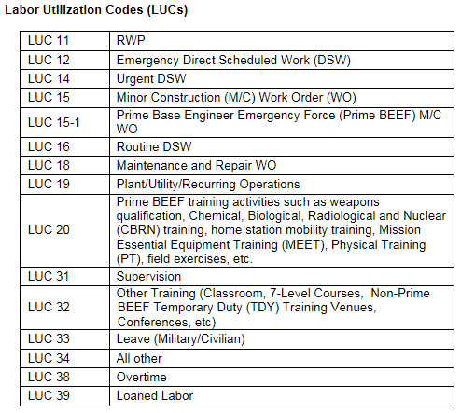
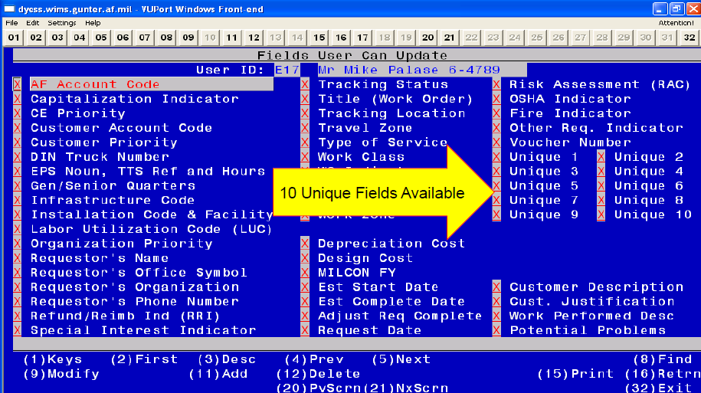
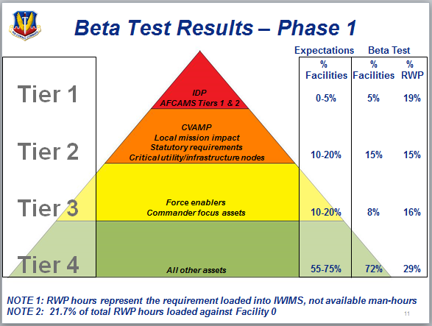
Data Summary
Overview
Problem Summary
Data Summary
Research Statement
Analysis Techniques
Results
Literature Search
IWIMS Data
LUC (Type work)
Worker type (civilian, military, contractor)
Shop
Hours performed
Work Request closed
Time to close
Base
MAJCOM

Slide 5
Research Statement
Overview
Problem Summary
Data Summary
Research Statement
Analysis Techniques
Results
Literature Search
This research investigated the effect of IWIMS data on the output of completing maintenance and repair work orders. A linear regression was performed to determine the factors that best facilitate greater output. These XXXX factors proved to best explain output. Furthermore, a model was developed to accurately depict the current maintenance output and predict workload based on changes to system inputs. The results of this analysis were developed into a framework providing a baseline for each unit’s expected output.

Slide 6
Analysis Techniques
Overview
Problem Summary
Data Summary
Research Statement
Analysis Techniques
Results
Literature Search
Linear Regression
Find factors that affect output
Monte Carlo Simulation
Model the effect issues will have over time
Show how changes in operations methods can improve output

Slide 7
Results
Overview
Problem Summary
Data Summary
Research Statement
Analysis Techniques
Results
Literature Search

Slide 8
Literature Search
Overview
Problem Summary
Data Summary
Research Statement
Analysis Techniques
Results
Literature Search
Factors contributing to productivity in facility maintenance and repair
Current Air Force methods of maximizing facility maintenance and repair
Future projections for Air Force Civil Engineering
TRIRIGA/NextGen IT
Additional data that will/should be tracked
Construction methods that decrease maintenance costs or time

